Slide 1
Module 8 Project selection (Part 2)
Mgmt 6054 project strategic management
Count slides & time before deleting

Slide 2
Module agenda
Project Selection (continued from last module)
Internal rate of return (IRR)
Benefit Cost Analysis (BCA)
Homework/evaluations
More agenda items

Slide 3
Project selection process
Project (or projects) being considered
Feasibility study
Benefit-to-cost analysis
CAN the project be done? Covered previously. Is the project viable, practical, and achievable?
SHOULD the project be done? Consider net present value, cash flows, rate of return, probability of success, reality of assumptions and constraints

Slide 4
Project selection benefit-to-cost (Financial) analysis
Financial analysis of projects using different methods:
Payback period analysis
Net present value (NPV) analysis
Internal rate of return (IRR)
Benefit Cost Analysis (BCA)
Last module
Today
More items?
Did you attempt the practice exercises?

Slide 5
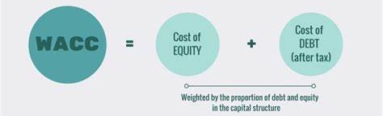
3. Cost of capital vs Internal rate of return
In the previous module we covered the cost of capital or r. Firms seek projects that exceed their cost of capital. The Internal Rate of Return or IRR, represents the return a specific project can generate, and how much higher the project return is than the cost of capital.
r=
The weighted average cost of capital (WACC)
Notes:
https://www.investopedia.com/terms/w/wacc.asp#:~:text=WACC%20is%20calculated%20by%20multiplying,in%20discounted%20cash%20flow%20analysis.

Slide 6
3. Internal rate of return (irr) Example
The IRR for a project is the discount/interest rate at which NPV = 0.
We might use our Cost of Capital, say a 15% interest rate, and calculate the NPV. If the NPV is greater than 0, then our return on the project will be greater than 15%.
But how much greater? Through trial and error we could keep increasing our interest rate from 15% to 16% until our NPV = 0. If 17.2% was the point where NPV = 0, then 17.2% is our IRR for the project, our Internal Rate of Return.
So in this case our IRR of 17.2% was 2.2% over our 15% Cost of Capital.

Slide 7
3. Internal rate of return (irr)
The discount/interest rate of a project where NPV = 0.
The higher the projected IRR on a project, and the greater the amount by which it exceeds the cost of capital, the higher the net cash flows to the company. If project looks profitable management should proceed with it – subject to affordability. On the other hand, if the IRR is lower than the cost of capital, the rule declares that the best course of action is to forego the project or investment.
Example: if IRR is 21% and weighted cost of capital is 10%, it would be a great investment, a high investment return. Note however, that high returns are usually accompanied by high risk.
Click Here, Video – What is Internal Rate of Return? (1min 30 sec)
https://www.investopedia.com/terms/i/internal-rate-of-return-rule.asp
Notes:
Reference - https://www.investopedia.com/terms/i/internal-rate-of-return-rule.asp

Slide 8
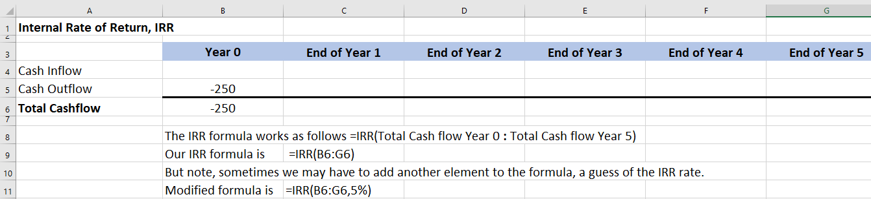
3. Internal rate of return (irr)
Calculation example ($ 000s):
80
80
80
80
80
0
1
2
3
4
5
Let’s try using IRR in Excel, create a spreadsheet per the screenshot below
250
25
25
You’ll need to calculate the “Total Cashflow” per year
Note the Excel IRR formula

Slide 9
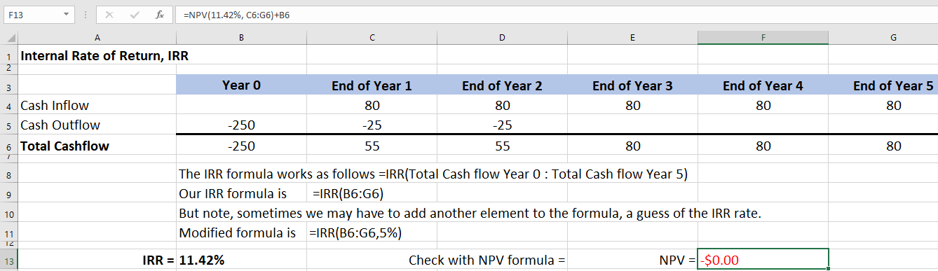
3. Internal rate of return (irr)
80
80
80
80
80
0
1
2
3
4
5
250
25
25
This is our IRR formula calculation
We used our IRR answer in an NPV formula to cross check

Slide 10

3. Internal rate of return (irr)
Sample question:
Based on a series of cash flows and a discount rate of 8%, NPV is calculated to be $1000. Without doing calculations, what is the best approximation of internal rate of return (IRR)?
10%
8%
5%
10%
8%
5%
Notes:
If we used a discount rate of 8% on a series of cash flows and calculated that NPV was exactly zero, then we can deduce that the rate of return for the project is exactly 8%. If NPV is greater than zero, then the rate of return has to be higher than 8%.

Slide 11
4. Benefit-Cost analysis
Decision making needs to consider all factors, not just financial considerations (i.e., qualitative and quantitative)
Let’s consider adding a new software solution at Fanshawe College:
Costs | Benefits
Software purchase | Long term efficiency gains (consider students and staff)
Installation | Better data
Training | Faster access
Documentation | Reputation for leading-edge
Learning curve (short term inefficiencies) | Improved compatibility with other software
Ongoing maintenance
Think of some possible or theoretical costs and benefits of a new software solution being used at the college (you don’t need $ estimates, just the name of the cost or benefit). It could be a new classroom scheduling system, or a new learning management solution (similar to FOL). When you’ve come up with at least 3 of each, move this graphic aside to reveal possible examples of costs and benefits.
Now, how do we “quantify” all of these items?

Slide 12

4. Benefit-COST analysis
Click Here
Video – Benefit Cost Analysis(6min)
https://www.youtube.com/watch/0EkufUCo5qI
Notes:
Image lucrumconsulting.net

Slide 13
4. Benefit-COST analysis
Benefit to Cost Ratio BCR
Dividing the cash inflow (benefits) by cash outflows (costs)
Benefits and costs usually are discounted
A ratio above 1.0 means the project should be profitable (benefits are greater than the costs) and the higher the ratio, the better
One of many profitability ratios
Benefit-Cost Ratio

Slide 14
A Reminder on Cost-Benefit analysis and benefit/cost analysis
A reminder ...
As a project manager, you may or may not be involved with the feasibility or benefit-to-cost analysis (sometimes called a cost benefit analysis).
Note: Cost-Benefit Analysis CBA is the same thing as a Benefit/Cost Analysis BCA.
The terms are used interchangeably in industry, but both typically use a Benefit Cost Ratio BCR where the benefits are the numerator and the costs are the denominator -- make sure you don’t reverse them.

Slide 15

“Go/no go” decision
Projects are analyzed based on feasibility (non-financial) analysis and financial analysis
The “go/no go” decision is made.
The project fits our corporate strategy and satisfies financial requirements.
Notes:
Image http://ponderfocus.pennypulz.com/addiction_recovery_podcast/decision-go-or-no-go/

Slide 16
Financial and non-financial analysis (similar to quantitative/qualitative)
Financial/Quantitative
Financial analysis including NPV, ROI, Payback Period
Quantitative risk analysis
Forecasts of revenue growth
Forecasts of customer satisfaction scores
Forecasts of market share changes
Non-Financial/Qualitative
Degree to which there is alignment to strategic goals
Potential windfall (unexpected gain)
Certainty of resource availability
Potential for legal or compliance issues
Perception of the public
Stakeholder enthusiasm for the project
Notes:
Image http://ponderfocus.pennypulz.com/addiction_recovery_podcast/decision-go-or-no-go/

Slide 17
Overall budget for projects
Cumulative Sum
Total Budget: $12M.
Which projects could be implemented based on priority ranking and estimated costs of the project.
The red line is used to “draw the line” on what can be performed given the budget limitation.

Slide 18
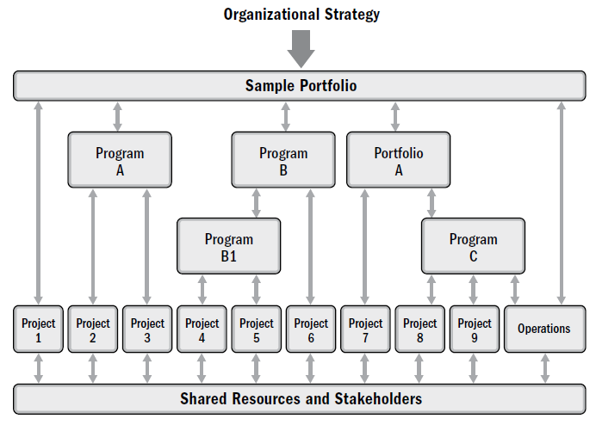
Overall budget for projects
Determining which projects will be implemented with a finite overall budget can be more complicated.
In this slide (used in a previous module), we can see how we might use not only projects in the previous slide, but entire programs or even portfolios. For example, if we want all of Program B implemented in order to capture the forecast benefits, we’d have to implement 3 projects together.
Notes:
Image – see references slide

Slide 19
Financial model comparison
Questions | Payback | Benefit to Cost Analysis | NVP Calculation | IRR
Measured how?
Tells us what?
Advantages?
Dis-advantages?
Firms will use more than one financial method to analyze their projects.
Handout this slide or fill in slide

Slide 20
Homework and evaluations
Readings (and other material) for next module as listed in Course Overview
Project Selection PRACTICE Quiz
Project Selection Quiz

Slide 21
references
Project Management Institute (2017). A Guide to the Project Management Body of Knowledge (Sixth Edition).
Kerzner, Harold (2017). Project Management, Twelfth Edition.
Watts, A. (2014). Project Management. Victoria, B.C.:BCcampus. Retrieved from https://opentextbc.ca/projectmanagement/.

